Slide 1
Boot & Bootloader
Based on LPIC book

Slide 2
Chapter 1: Boot
The Boot Process
BIOS
UEFI
Bootloader
Kernel
dmesg
init

Slide 3
The Boot Process
Boot process steps:
Motherboard Firmware does a PowerOnSelfTest
Motherboard loads the bootloader
Bootloader loads the Linux Kernel-based on its configs/commands
The Kernel loads and prepares the system (root filesystem) and runs the initialization program
Init program start the service, other programs, ... (web server, graphical interface, networking, etc.)
The Firmware on the motherboard can be BIOS or UEFI.

Slide 4
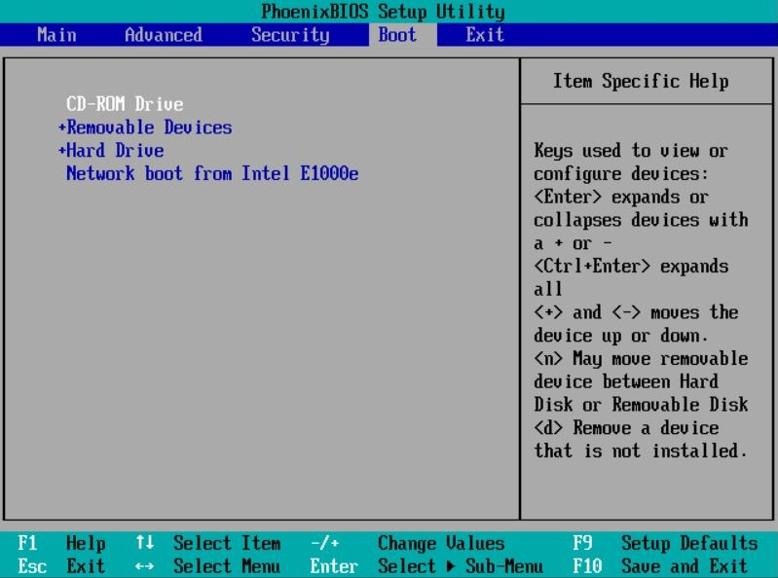

Slide 5
BIOS
Basic Input Output System
Older
Limited to one sector of the disk and needs a multi-stage bootloader
Can start the bootloader from internal/external HDD, CD/DVD, USB Flash drive, Network server
If booting from the HDD, the Master Boot Record will be used (1 sector)

Slide 6
UEFI
Unified Extensible Firmware Interface.
Modern and fancy
Specifies a special disk partition for the bootloader. Called EFI System Partition (ESP)
ESP is FAT and mounted on /boot/efi and bootloader files has .efi extensions
You can check /sys/firmware/efi to see if you are using a UEFI system or not

Slide 7
Bootloader
Bootloader initializes the minimum hardware needed to boot the system and then finds and runs the OS.
Technically you can point your UEFI to run anything you want but typically under GNU/Linux systems, we use GRUB. Even the GRUB can be used to run any specific program you need but generally it runs the OS.

Slide 8
Kernel
The Kernel is the core of your operating system, the LINUX itself. Your bootloader loads the kernel in the memory and runs it. But kernel needs some initial info to start; Things like drivers are necessary to work with the hardware. Those are stored in initrd or initramfs alongside the kernel and used during the boot.
You can also send parameters to the kernel during the boot using the Grub configs. For example, sending a 1 or S will result the system booting in single-user mode (recovery). Or you can force your graphics to work in 1024×768x24 mode by passing vga=792 to the Kernel during the boot.

Slide 9
dmesg
Linux will show you the boot process logs during the boot. Some desktop systems hide this behind a fancy boot splash which you can hide using the Esc key or press Ctrl+Alt+F1.
dmesg command will show the full data from kernel ring buffer up to now. But cat /var/log/dmesg will show only the data during the boot.
Fun Fact: During the bootup, only The Kernel is running so it should record and keep its logs!

Slide 10
init
When the Kernel finished its initialization, its time to start other programs. To do so, the Kernel runs the Initialization Daemon process, and it takes care of starting other daemons, services, subsystems and programs. Using the init system one can say "I need service A and then service B. Then I need C and D and E but do not start D unless the A and B are running". The system admin can use the init system to stop and start the services later.

Slide 11
init
There are different init systems:
SysVinit is based on Unix System V. Not being used much but people loved it and you may see it on older machines or even on recently installed ones
systemd is the new replacement. Some people hate it but it is being used by all the major distros. Can start services in parallel and do lots of fancy stuff!
upstart was an event-based replacement for the traditional init daemon. The project was started in 2014 by Canonical (the company behind Ubuntu) to replace the SysV but did not continue after 2015 and Ubuntu is now using the systemd as its init system.

Slide 12
init
The init process had the ID of 1 and you can find it by running the
You can check the hierarchy of processes using the pstree command.
# which init
/sbin/init
# readlink -f /sbin/init
/usr/lib/systemd/systemd
# ps -p 1
PID TTY TIME CMD
1 ? 00:00:06 systemd
pstree

Slide 13
Chapter 2: Bootloader
Boot overview
GRUB
GRUB Legacy
GRUB2
GRUB2 commands
Interacting with GRUB2
Kernel boot parameters

Slide 14
Boot overview
Most systems use BIOS or UEFI. When on BIOS, the system will do a self test called POST (Power-On Self-Test). Then it will hand over the boot process to the first sector of Master Boot Record (MBR) which is track (Cylinder) 0, side (Head) 0 and Sector 1 of the first disk.
MBR is only 512 bytes so we need a smart bootloader to handle larger boot managers and even multiple systems. Some of these boot loaders are LILO, GRUB and GRUB2.

Slide 15
Boot overview
If the system is using UEFI, the hardware will follow the UEFI stages. They start with a security phase and will continue till the end phase where the UEFI looks for an EFI System Partition, which is just a FAT32 partition (Usually the first one, but that's implementation-defined) with PE executables and runs them.
In both cases, the binary starts the boot loader. It might be a complete bootloader on /boot/efi/ of your computer or a small loader for the main grub on the MBR or a windows loader or even a chainloader.
Chain Loading is when a boot loader, loads another boot loader. This is done when a Linux bootloader needs to start a Windows system.

Slide 16
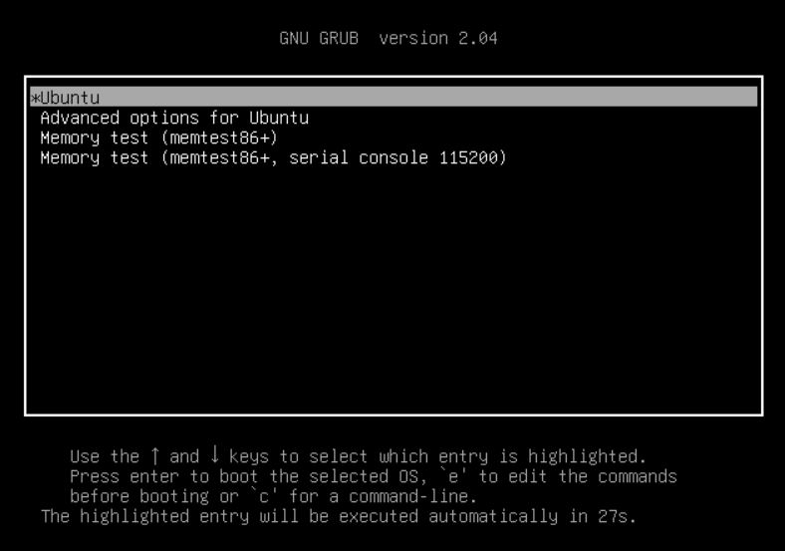

Slide 17
GRUB
GRUB (GRand Unified Bootloader) started to replace the older LILO. The first version (1) is called Grub Legacy and started in 1999. The 2nd version started in 2005 and is a complete rewrite of version 1.
It's a menu-based system where you can choose which Kernel or chainloader to boot. It is also possible to edit the menus on the fly or give direct commands from a command line.

Slide 18
GRUB Legacy
Usually the GRUB v1 (actually 0.9) is installed in /boot/grub. Its main configuration is in /boot/grub/menu.lst but nowadays some distros (including RedHat Based ones) link this to the /boot/grub/grub.conf.
A sample menu.lst / grub.conf file for GRUB legacy consists of two sections. The first section contains global configs and the 2nd part defines different kernel/initram or chainloader options.

Slide 19
GRUB Legacy
The global configs are:
Config | Description
# | Comment
color | Foreground and background colors for normal and active items
default | Which boot menu item is the default
fallback | Which boot menu should be used if the default fails
hiddenmenu | Hide the menu options
splashimage | Show this image in the background!
timeout | Wait this much and then start the default
password | Security is important! Will ask this password
savedefault | Remember the last booted item

Slide 20
GRUB Legacy
On the second part of the config, we have these:
Config | Description
title | Defines the section name
root | Disk and partition where /boot directory is. In the form of (hddrive, partition), say (hd0, 0) or (hd0, msdos0)
kernel | Kernel image file name in /boot
initrd | Initramfs file in /boot
rootnoverify | Defines a non-Linux root partition
chainloader | Another file will act as stage 1 loader. Used for booting Windows systems

Slide 21
# grub.conf generated by anaconda
#
# Note that you do not have to rerun grub after making changes to this file
# NOTICE: You do not have a /boot partition. This means that
# all kernel and initrd paths are relative to /, eg.
# root (hd0,5)
# kernel /boot/vmlinuz-version ro root=/dev/sda6
# initrd /boot/initrd-version.img
#boot=/dev/sda6
default=1
timeout=10
splashimage=(hd0,5)/boot/grub/splash.xpm.gz
#hiddenmenu
password --md5 $1$RW1VW/$4XGAklxB7/GJk0uO47Srx1
title Upgrade to Fedora 11 (Leonidas)
kernel /boot/upgrade/vmlinuz preupgrade \
repo=hd::/var/cache/yum/preupgrade stage2=\
hd:UUID=8b4c62e7-2022-4288-8995-5eda92cd149b:/boot/upgrade/install.img \
ks=hd:UUID=8b4c62e7-2022-4288-8995-5eda92cd149b:/boot/upgrade/ks.cfg
initrd /boot/upgrade/initrd.img
title Fedora (2.6.26.8-57.fc8)
root (hd0,5)
kernel /boot/vmlinuz-2.6.26.8-57.fc8 ro root=LABEL=FEDORA8 rhgb quiet
initrd /boot/initrd-2.6.26.8-57.fc8.img
title Fedora (2.6.26.6-49.fc8)
root (hd0,5)
kernel /boot/vmlinuz-2.6.26.6-49.fc8 ro root=LABEL=FEDORA8 rhgb quiet
initrd /boot/initrd-2.6.26.6-49.fc8.img
title GRUB Menu
rootnoverify (hd0,1)
chainloader +1
title Windows
rootnoverify (hd0,0)
chainloader +1
A sample of GRUB-Legacy config

Slide 22
GRUB2
This is the most common boot loader these days. On BIOS systems it is installed on /boot/grub/ or /boot/grub2/ and under UEFI it goes in /boot/efi/EFI/distro-name/ (say /boot/efi/EFI/fedora/). GRUB2's configuration file is called grub.cfg.

Slide 23
GRUB2
Here is a simplified grub.cfg:
As you can see, GRUB uses Linux-style numbering for partitions, so the first partition on the first hard disk is (hd0,1) or (hd0,msdos1) for DOS partitions or (hd0,gpt1) for GPT drives.
set default="0"
menuentry "Fedora" {
set root=(hd0,1)
linux /boot/vmlinuz-5.10.0-9-arm64 ro quiet
initrd /boot/initrd.img-5.10.0-9-arm64
}
menuentry "Windows" {
chainloader (hd1,msdos2)+1
}

Slide 24
GRUB2
Here you can see some of the options:
Option | Description
menuentry | Defines a new menuentry
set root | Defines the root where /boot located
linux, linux16 | Defines the location of the Linux kernel on BIOS systems
linuxefi | Defines the Linux kernel on UEFI systems
initrd | Defines the initramfs image for BIOS systems
initrdefi | Defines the initramfs image for UEFI systems

Slide 25
GRUB2 commands
The installation is done with grub-install /dev/sda and after changing the config files, you need to issue grub2-mkconfig or grub-mkconfig. It reads the configuration files from /etc/grub.d/ and /etc/default/grub/ and create the grub.cfg file based on them. You run it like this:
or
grub2-mkconfig > /boot/grub2/grub.cfg
grub2-mkconfig -o /boot/grub2/grub.cfg

Slide 26
GRUB2 commands
There is also a command called update-grub as a frontend to grub-mkconfig which runs grub-mkconfig -o /boot/grub/grub.cfg
Please note that on some modern distros, you have both grub and grub2 commands available for compatibility reasons, and one links to the other.

Slide 27
Interacting with GRUB2
If you press c on the grub menu, you will go into the GRUB Command Line or GRUB shell. There you can type commands like root and kernel and initrd and boot the system with boot or press the Esc key to return back to the menu.

Slide 28
Kernel boot parameters
In the above configs, we sent some parameters to the kernel like this:
This tells the kernel to boot in ReadOnly mode and does not show lots of logs during the boot (quiet).
linux /boot/vmlinuz-5.10.0-9-arm64 root=/dev/sda1 ro quiet

Slide 29
Kernel boot parameters
Option | Description
console= | Set the console
debug | Start in debug mode
init= | Run an specific program instead of the default init
initrd= | Use this initrd
ro | Mount the root filesystem read only
rw | Mount the root filesystem for read and write
root= | Use this as the root filesystem
selinux | Disable selinux on boot
single,S,1,Single | Boot in single user mode for troubleshooting (SysV)
systemd.unit= | Boot in this systemd target

Slide 30
Explore more…
GRUB Manual:
https://www.gnu.org/software/grub/manual/grub/grub.html
GRUB Documentation:
https://www.gnu.org/software/grub/grub-documentation.html
GRUB Source Code:
https://github.com/coreos/grub/
Linux Source Code:
https://github.com/torvalds/linux

Slide 31
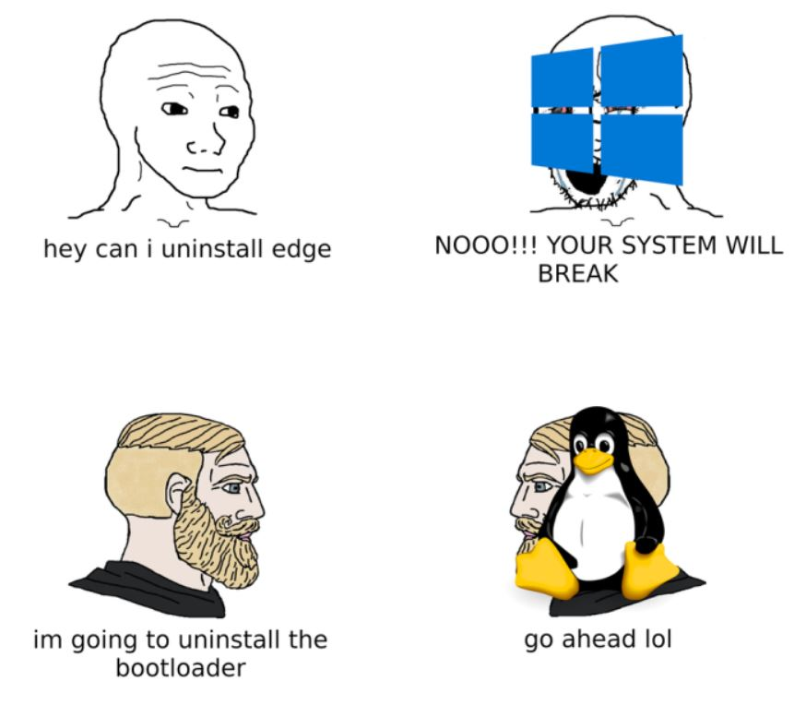
The End

